Slide 1
Data Admin Meeting
p/b Educational Data Services at CNYRIC
(slides last updated September 24, 2020 12:30 PM (Now))
Location: Remote
September 24, 2020 1:00 - 3:00 pm
Please send your name and your district to Ami Ineich (aineich@cnyric.org) - Subject line: Data Admin Attendee

Slide 2
Agenda
Welcome
System Updates
Assessment
Student Reporting
Staff Reporting
Attendance Forum
Documents available at: http://www.cnyric.org/teacherpage.cfm?teacher=1055
2020-21 SIRS Manual: http://www.p12.nysed.gov/irs/sirs/ (v 16.0 - 08/25/2020 update)
Vendor Meeting Info: http://www.p12.nysed.gov/irs/vendors/home.html
2020-21 Reporting Timeline and Memo: http://www.p12.nysed.gov/irs/

Slide 3
Educational Data Services Updates
Level 0 updated to v16.0 and open for loading
Level 1 warehouse is being upgraded but is open for 20-2021 data.
Level 2 reports for 2020-21 data are populating as data is loaded
Level 0 Historical - opens October 26 for 2019-20 SY data; data will move to L2 at
a later date
SchoolTool upgrades to Ver. 18.1 completed early September
New Release meeting & Attendance Forum - Thursday, October 1, 2020 from 1:30 to 3:30; Register at: https://www.mylearningplan.com/WebReg/ActivityProfile.asp?D=15882&I=3618754

Slide 4
Educational Data Services Updates
Reminder to update SEDREF with any district administrative changes
Level 0 Updates
New Security
  Timeout period will be increased to 15 (from 10) minutes in next release
  Previously - security questions added
  Password resets can now be completed by users
Program Fact
  Program Fact Import - Optional Pre-Check Process
  Pre-check does not work for auto-loads
Help Document

Slide 5
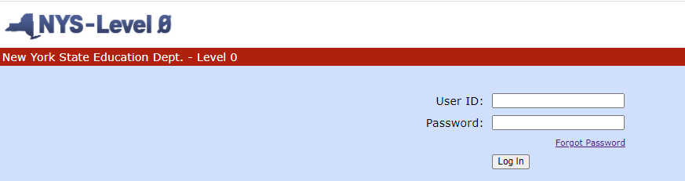
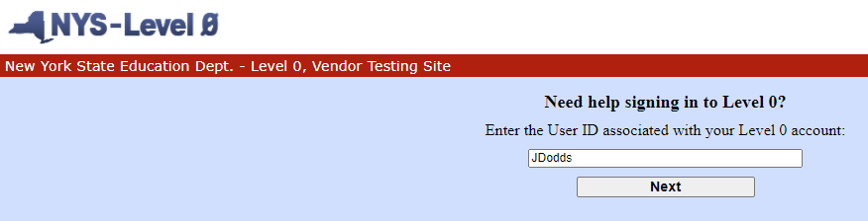
Level 0 Password Reset
“Forgot Password” now appears on login screen. Click “Forgot Password”.
Enter your User ID and click “Next”

Slide 6
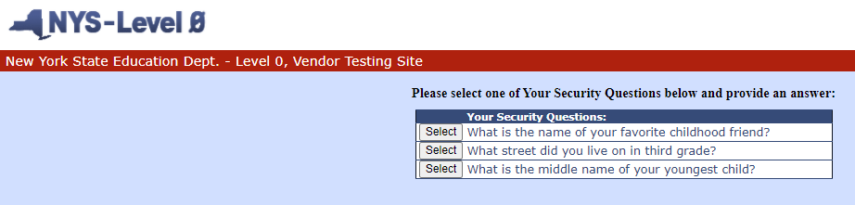
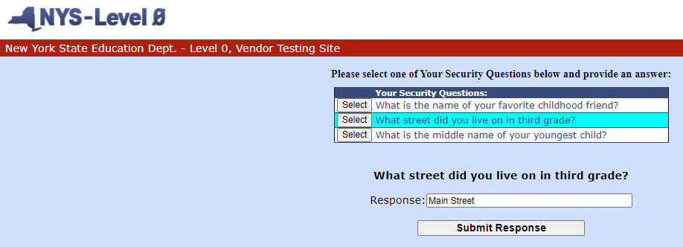
Level 0 Password Reset
Click on a security question to answer, type answer and click “Submit Response”

Slide 7
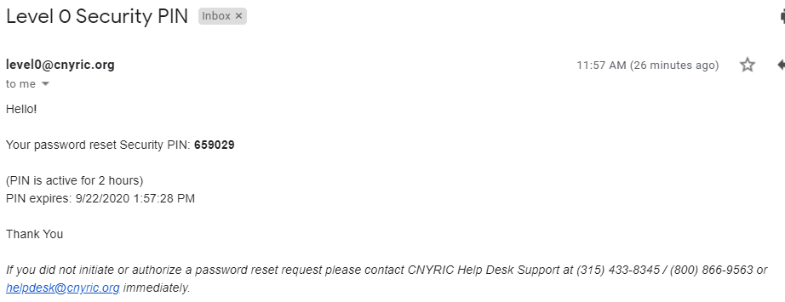
Level 0 Password Reset

Slide 8
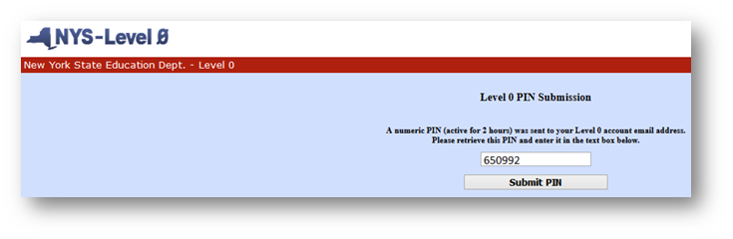
Level 0 Password Reset
Enter the PIN from email and click “Submit PIN”

Slide 9
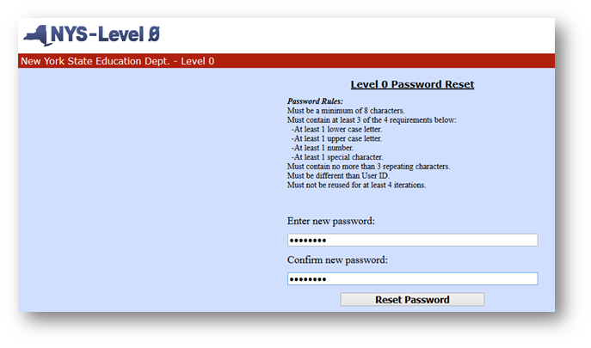
Level 0 Password Reset
Enter your new password abiding by the password rules, confirm your new password and click “Reset”

Slide 10
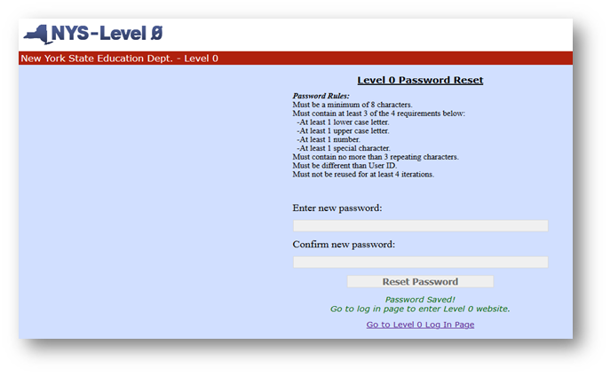
Level 0 Password Reset
Must then click “Go to Level 0 Log In Page” where you can log in with new password

Slide 11
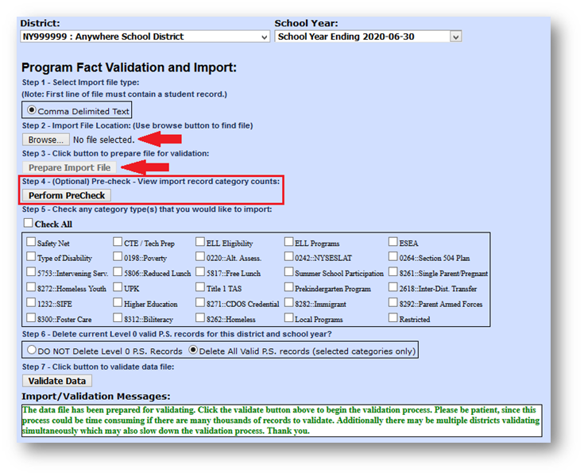
Level 0 Program Fact (Optional) PreCheck

Slide 12
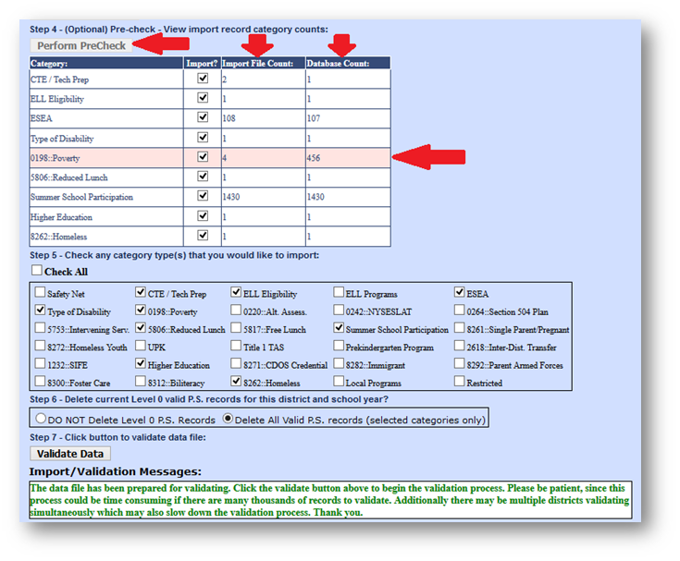
Level 0 Program Fact (Optional) PreCheck
Click “Perform PreCheck” button
Reads the Import File (Step 2)
Automatically places a check mark in each applicable Category for Import in both the PreCheck Category list (Step 4) and the full list of Category types (Step 5)
If the Import File Count is less than the Database Count for any of the selected categories, that Category or Categories will be highlighted for manual review to ensure that the Category should be imported

Slide 13
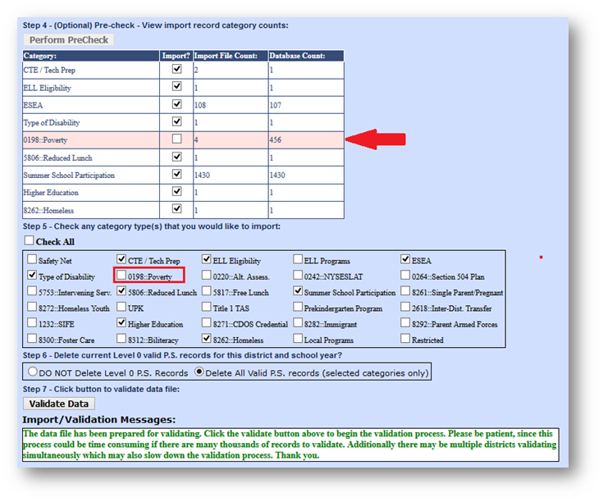
Level 0 Program Fact (Optional) PreCheck
If user determines that a Category should not be Imported, uncheck the checkbox in either the PreCheck (Step 4) or full Category type list (Step 5) and it will be unchecked in both places.
When the Category checkboxes are accurate, the Validate Data button can be selected to complete the Program Fact Import process for the selected Categories.

Slide 14
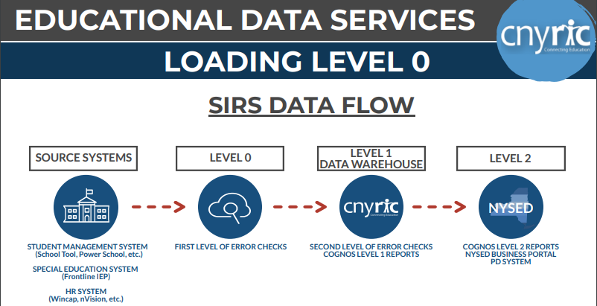
CNYRIC Level 0 Guide Document
See meeting handouts: https://www.cnyric.org/teacherpage.cfm?teacher=1055

Slide 15
Assessment - Regents
“Tentative” Regents Exam Schedules for January, June & August 2021 http://www.p12.nysed.gov/assessment/schedules/schedule-hs.html
  January 26 - 29, 2021
  New US History and Government (Framework) Exam - June 2, 2021
  June 15 - 25, 2021
  August 12 - 13, 2021
Global History and Geography
  Transition Global History Exam will no longer be administered - last scheduled administration was June 2020
  Global History and Geography II will be the only exam Global available in January 2021 and thereafter - courses must be mapped to State Course Code 04052NF

Slide 16
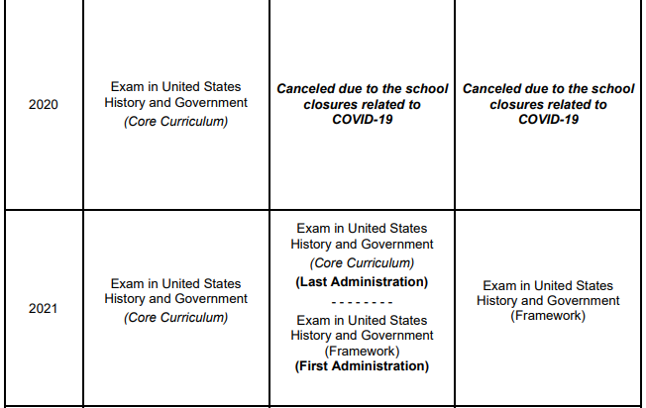
Assessment - Regents
US History and Government - which standards are being taught?
  Core Curriculum - Course code 04101 (Old)
  US History and Government (Framework) - Course code 04101F (New)

Slide 17
Assessment - Regents
Issue: “Transferred In” Indicator in SchoolTool (email August 17, 2020)
  Assessments marked as “Transferred In” no longer export to the warehouse (as of April 2020)
    “Transferred In” intended for use with students transferring into the district
    Assessments from previous district(s) would be reported by previous district(s)
    Removing these records from Assessment Fact export prevents double reporting
  Some districts have used “Transferred In” for BOCES or other OODP students
  Potential impact to June 2020 exemptions reporting
    If you have exemptions marked as “Transferred In”, they will not export
Exemptions
  June 2020 exemptions must be reported by October 8, 2020
    Note: August exemptions are 20-21 data
  Check SIRS-309 report - exemptions show in PHE (Public Health Event) column (h)
  Be aware of exemptions marked as “Transferred In”

Slide 18
Assessment - Regents
Assessment Fact reporting issues
  Regents Assessment Fact reported by districts
  Regents Assessment Response and Assessment Accommodations & Modifications reported directly from CNYRIC Test Scoring
  Every year, Test Scoring must resolve hundreds of discrepancy issues from SED audits
    Scores reported for incorrect exams
    Fact records disagreeing with response records
    Fact records with no response records
  Internal team reviewing reporting process to improve accuracy of reporting

Slide 19
Assessment - 3-8 Testing
District Test Coordinator (DTC) Verification
  Check SEDREF for NYSAA and 3-8
Ordering system for 3-8 assessments will be opening soon
  Look for SED memo regarding this process
CBT info - https://cbtsupport.nysed.gov

Slide 20
Assessment - NYSAA
Reporting NYSAA eligibility
  Reported as ungraded
  Program Fact 0220 - Eligible for Alternate Assessment
  Program Service Code for Type of Disability
  Note: Assessment based on age - not grade
https://cbtsupport.nysed.gov/hc/en-us/categories/201173593-New-York-State-Alternate-Assessment-NYSAA-ELA-Math-and-Science

Slide 21
Assessment - NYSITELL
Continue testing students as needed
  Within 10 days of enrollment
All data must be filled out or documents cannot be processed
  Legible Name (Last Name, First Name)
  Grade and Test Date bubbled in
  Legible ID Number
For security, all score reports are password protected and sent to one main contact
Reminder: All forms need to be processed and reported even if the student was unable to respond

Slide 22
Assessment - AIS
2019-20 Guidance Memo (not 2020-21) http://www.p12.nysed.gov/sss/documents/201920_AISMemo.pdf
From Board of Regents:
  Flexibility in AIS Identification: Schools are not required to conduct the two-step identification prescribed for identification of students in grades 3 through 8 to receive AIS for the 2020-21 school year due to the cancelation of State assessments for the 2019-20 school year due to the COVID-19 crisis. http://www.nysed.gov/news/2020/board-regents-acts-fourth-series-emergency-regulations-ease-burdens-educators-students-and
  Districts shall use a district developed procedure, to be applied uniformly at each grade level, for determining which students are entitled to such services. Districts may consider students’ scores on multiple measures of student performance, such as:
    Developmental reading assessments
    Benchmark and lesson embedded assessments
    Common formative assessments
    Unit and lesson assessments
    Results of psychoeducational evaluations
    Diagnostic screening for vision, hearing, and physical disabilities as well as screening for possible disabilities pursuant to Commissioner’s Regulations Part 117.

Slide 23
Student Reporting
BEDS Day is Wednesday, October 7, 2020
Collection of BEDS online IMF
  Available via IDEx on Wednesday, October 7
  Due by Friday, November 20
  Instructions http://www.p12.nysed.gov/irs/beds/IMF/home.html
October 8: August Grads data due - deadline to submit data for graduates as of August 31, 2020 - Total Cohort (SIRS-201) for graduation rate

Slide 24
Student Reporting - NYSSIS
NYSSIS (NYS Student Identification System)
  NYSSIS compares new enrollments against existing student database
  Matches students based on several fields - places near matches in queue for resolution
  Match process is being revamped - expected implementation 2021-22
  New “required” fields now being used
    Guardian 1
    Address 1 (highly recommended this be a physical address)
    City
    State
    Zip
    Primary Phone
  Warning error on records with empty values in these required fields - will prevent loading in the future

Slide 25
Student Reporting - Day Calendar
Public Health Event (PHE) Day Type Codes for 2020-21
Only used if there is a local Department of Health directive or Executive Order for school closure. For all other situations, use other existing Day Type codes
Pub health/inst
  Public Health Event with continuity of learning provided
  All students are expected to be engaged in the continuity of learning provided
  For 20-21: included in calculations (e.g., chronic absenteeism, suspensions, etc.) and negative attendance must be reported
Pub health/no inst
  Public Health Event with no continuity of learning provided
  No instruction was provided
  NOT included in calculations and negative attendance should NOT be reported

Slide 26
Student Reporting - Day Calendar
Remote Snow Day Pilot for 2020-21 School Year
As part of the Department’s ongoing efforts to provide districts with flexibility in meeting local needs during the pandemic, the Department is establishing a one-year pilot to enable school districts, at district option, and consistent with each district’s re-opening educational plan, to pivot to remote instruction to provide continuity of instruction on what would otherwise be a day of school closure due to a snow emergency. This pilot is in effect for the 2020-21 school year, after which the Department will review the outcome of the pilot in determining whether to continue this flexibility in subsequent school years.

Slide 27
Student Reporting - Program Services
Deleted Program Service Codes:
  5720 - Title III: Services to Non-Immigrant ELL/MLL Students
  5731 - Title III: Language Instruction Immigrant ELL/MLL Students
Added Program Service Code:
  3055 - ELL Eligibility Exit due to being out of the country for more than two years
Modified (Split) Program Service Codes
  5753 (modified) - Coordinated Early Intervening Services (CEIS) supported with IDEA funds. Voluntary – LEAs can choose to use a portion of their IDEA Part B funds for services to a defined group of at-risk students. Only for children who are not currently identified as needing special education or related services.
  5754 (new) - Comprehensive Coordinated Early Intervening Services (CCEIS) supported with IDEA funds. Mandatory – LEAs identified as having significant disproportionality in identification, placement, and/or disciplinary removals must use IDEA Part B funds for CCEIS. May be used (but not exclusively) for children currently identified as needing special education or related services

Slide 28
Student Reporting - Program Services (ELL)
ELL Services Duration (ELL Duration) now calculated by NYSED:
Number of cumulative days and corresponding years that a student identified as ELL Eligible (Program Service Code 0231) has received ELL services:
  5709 (English as a New Language)
  5676 (Transitional Bilingual Education Program), or
  5687 (One Way or Two Way Dual Language Program)
  Program Service Code 8239 (ELL Eligible but not in an ELL Program) is not counted
Report all ELLs attending school in U.S. less than one year as of April 1, 2021 with Program Service Code 0242 (Eligible to take the NYSESLAT for grades 3-8 ELA Accountability) Note: 0242 eligible students from 2019-20 will NOT automatically have the eligibility extended to the 2020-21 academic year. ESEA specific that this provision applies only to students attending a school in the U.S. for less than one year.

Slide 29
Student Reporting - Program Services (FRPL)
Direct Certification Match Process (DCMP): Food Service - entitle NYSSIS Role: Child Nutrition User http://www.cn.nysed.gov/content/new-state-wide-direct-certification-matching-process-and-mandatory-reporting-snapmedicaid
FRPL Eligibility reasons - DCMP, Application, Household siblings, Homeless, Migrant, Runaway, Foster, FDPIR, HSTART, Carryover (30 operating days from first day of school or 30 days for a student who transfers from a CEP school at any point in the SY)
DCMP must be run a minimum of 3x a year
  Best practice for the first DCMP download is as close to the beginning of the school year as possible.
  First available this year September 8, 2020.

Slide 30
Student Reporting - Program Services (FRPL)
Start of school year 2020-2021 Child nutrition has struggled matching the DOH files.
  Send Demographics and Enrollment files so Child Nutrition NYSSIS match to your district works
  Suggest processing DCMP import to the food service package as many times as possible prior to BEDS day
Best Practice suggest running DCMP on a monthly basis. The DOH sends files of newly eligible students monthly.

Slide 31
Student Reporting - Program Services (FRPL)
Continued in School Year 2020-2021 from the 2019-2020 school year is a change for reduced students. The NYS budget, for the 2020-2021 school year, includes the provision of NYS to pay the reduced amount instead of the students.
For DW reporting still report the free or reduced eligibility.
For Child Nutrition request for meal reimbursement report free, reduced and paid meals served. NYSED will be paying the reduced fee formerly charged to students as they walked through the lunch line.
USDA is extending Federal Cares Act funding until December 31, 2020. All students are fed a reimbursable meal for free.

Slide 32
Student Reporting - Program Services (FRPL)
CEP Caution: CEP schools specifically are directed to only process the DCMP once a year. This is inadequate for Data Warehouse BEDS reporting.
Suggested best DCMP import timing for CEP schools or districts
1. Before School starts process the DCMP
2. After demographics and enrollments have been loaded to DW but before BEDS day. Or upload a roster match file to NYSSIS child nutrition. This includes K or new students moved into the district over the summer.
3. Before the date for qualification for continuing CEP eligibility (generally March or April)

Slide 33
Student Reporting - Program Services (CTE)
CTE - State-Ed Approved District Programs
  CTE Approved Program Listing: http://www.p12.nysed.gov/cte/ctepolicy/approved.html
  Reportable as CTE Program Services using approved CIP codes
  Technical Assessments
  Program Name, Courses, Teacher Certification, Program Requirements
  Program Intensities
    Participant
    Concentrator
  Exit Status (Seniors, Students who have left the district)
  CTE Endorsement

Slide 34
BOCES Enrollment, CTE, New Vision References
BOCES Enrollment
  BOCES Virtual Location Codes
  Program Name, 4-Digit Code, Location, Principal, Description
BOCES CTE CIP Codes, New Vision
  State-Ed approved BOCES CTE courses are approved for the pathway
  CTE Program Name, CIP Code, State-Ed Approval Status
  New Vision Program Name (not part of CTE Program Service reporting)
  BOCES Reference documents: www.cnyric.org → Resources → Codes and Definitions (Locations and CTE CIP Codes) https://www.cnyric.org/teacherpage.cfm?teacher=847

Slide 35
Student Reporting - Course Data
Course Codes - http://www.p12.nysed.gov/irs/courseCatalog/
Course code changes http://www.p12.nysed.gov/irs/vendors/
Report course data using locations consistent with 2019-20
Use unique section codes for groups of students assigned to the class within a building, even if using forms of instruction different from the traditional face-to-face mode. Average class size statistics are derived by using counts of students assigned to a section. Course/sections for a class must be maintained (cannot be changed) throughout the 2020-21 school year.
For itinerant teacher reporting, follow guidelines in the SIRS Manual.

Slide 36
Student Reporting - Course Data
Primary Instruction Delivery Method Code
  Reported on Course Instructor Assignment
  Must be reported based on the development of the course as it was originally intended and designed to be delivered.
  In most cases, this would be the same as was reported for the course last year.
  Code must remain the same during the school year as it is not dependent on changes in student scheduling included in reopening plans, including social distancing, hybrid, or remote learning.
All changes to course reporting (including scheduling students in temporary alternative locations to ensure social distancing or other LEA needs) should be thoroughly reviewed with your SchoolTool consultant (or other SMS vendor rep) to ensure correct codes are exporting in their extracts

Slide 37
Student Reporting - School Registration Changes
Schools should report data in SIRS to SED using the BEDS code of the school students WOULD HAVE been in had COVID not happened.
  For example, If you have a grade 3 student who would have been going to school in the elementary school but the district is educating their high school students remotely and moving their grade 3 students into the high school location to social distance until COVID is over, the student should be reported with the BEDS code of the elementary school, NOT the high school.
If students from multiple schools ARE BEING COMBINED AND TEACHERS FROM THOSE BUILDINGS ARE NOW TEACHING STUDENTS FROM MULTIPLE SCHOOLS, THAT is a reconfiguration (that may be temporary - for this one school year, or permanent if the District decides they are making it a permanent reconfiguration). This requires submission to Office of Accountability through their School Registration/Grade Reconfiguration Process.

Slide 38
Student Reporting - Attendance
(Reopening Guidance, p 8) “the content of data submissions, such as attendance data, will remain consistent with past practice, except where modified by law, regulation or executive order.”
Schools must develop a mechanism to collect and report daily teacher student engagement or attendance. ... a procedure should be developed to make daily contact with students in remote or hybrid settings.
Attendance data must be reported in the student information reporting system or SIRS.

Slide 39
Student Reporting - Attendance
ATTENDANCE AND CHRONIC ABSENTEEISM (Reopening Guidance, p 81)
Remote learning did not work for everyone during the spring 2020 school closure
In many schools and districts, large numbers of students did not log on or otherwise participate in online learning opportunities
It is therefore critical for schools to use a variety of creative methods to reach out to students and their families who did not engage in distance learning
School policies and procedures must focus on the academic consequences of lost instructional time and address absences before students fall behind in their learning

Slide 40
Student Reporting - Attendance
Could a district only take daily attendance for those remote learners at middle and high school, instead of both daily and period by period attendance?
the Department is working on providing guidance
per CR 104.1, a school district has to have an internal mechanism in place to maintain period by period attendance
Until the Department provides further guidance, please encourage your districts to utilize any method (electronic or otherwise) to maintain accurate class attendance of all students regardless of the mode of instruction.
SchoolTool v18.1 introduced new the new functionality of a “Remote” checkbox for teachers to use when submitting their attendance. Use of this field is key for data collection for upcoming reporting features of SchoolTool. The document, Remote Option Checkbox, provides more details on this feature.

Slide 41
Staff Reporting - Certification Process
Staff Student Course Template removed
No more ePMF, TAA, or TSDL
Staff Snapshot due by November 6 - need Course Instructor Assignment reported as well
Annual Certification Match Process Beginning in 2020-21
  Course Instructor Assignment Data and NYSED teacher certification database
    Flag special education and ENL (ESL) certified teachers with appropriate CIA indicators
    Report Bilingual teachers using the Primary Instruction Language code other than English
  Current certifications viewed via SIRS-329 - Staff Certification Report
  Certification match updated weekly and available in the SIRS-328 - Staff Out of Certification Verification Report
  Teachers who do not have the appropriate certification for the reported course will be deemed to be teaching out of certification. Districts should review the course to certification crosswalk (Crosswalk) mapping distributed via the NYSED IRSP (also posted with our handouts)
  Incidental teaching expanded to 10 hours per week (2 courses)

Slide 42
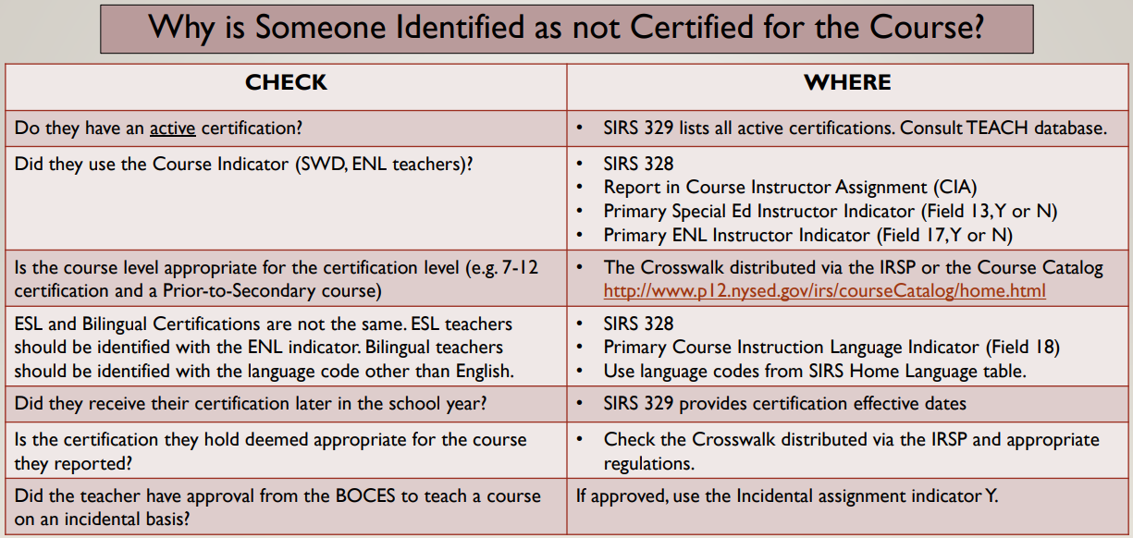
Staff Reporting - Certification Process

Slide 43
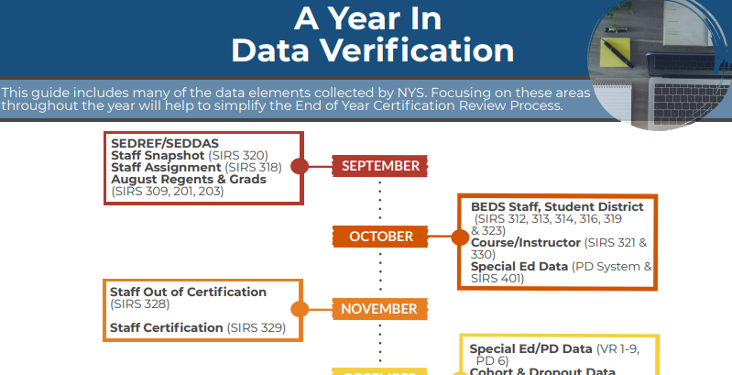
CNYRIC Year in Verification Timeline
See meeting handouts: https://www.cnyric.org/teacherpage.cfm?teacher=1055

Slide 44

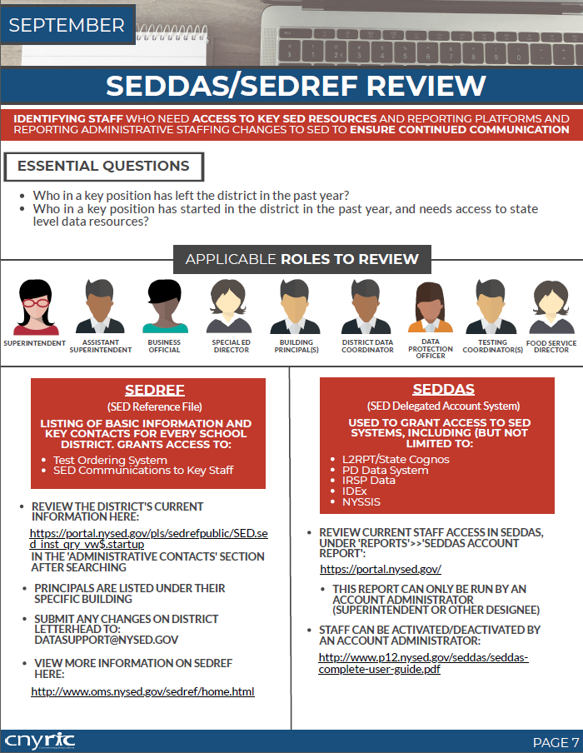
CNYRIC Year in Verification Guide
See meeting handouts: https://www.cnyric.org/teacherpage.cfm?teacher=1055

Slide 45
Upcoming Dates
October 1: SchoolTool New Release & Attendance Forum meeting
October 7: BEDS Day
October 8: Deadline to submit Regents exemptions from June 2020 and any AP or IB scores from 2019-20
October 8: Deadline to submit graduates as of August 31, 2020 for Total Cohort Graduation Rate reporting
November 5: Staff Snapshot data due - must be loaded prior to loading any other staff or course data to SIRS

Slide 46
Data Admin Meetings for 2019-20
✔ Thursday, September 24, 2020 – 1:00 - 3:00 PM
Thursday, November 19, 2020 – 1:00 - 3:00 PM
Thursday, January 28, 2021 – 1:00 - 3:00 PM
Thursday, April 15, 2021 – 1:00 - 3:00 PM
Thursday, June 24, 2021 – 1:00 - 3:00 PM
Please send your name and your district to Ami Ineich (aineich@cnyric.org) - Subject line: Data Admin Attendee

Slide 47
Remote Connection
Topic: Data Admin Meeting
Time: Sep 24, 2020 01:00 PM Eastern Time (US and Canada)
Join Zoom Meeting:
https://cnyric.zoom.us/j/92481594571?pwd=TXlBb0dDQ29lUCtTRDBlNjRJMVgzZz09
Meeting ID: 924 8159 4571
Passcode: 474421
If joining by phone
+1 646 876 9923 US (New York) or +1 646 518 9805 US (New York)

Slide 48
Attendance Forum
Current Practice or Policy
Questions or Concerns

