Slide 1
Computer-Based Testing Fast Track NYSSIS ID Est. 2017
2019

Slide 2
Fast Track NYSSIS ID
Fast Track NYSSIS ID is only available to operational CBT Schools:
Available as a link within the NYSSIS ID app as part of the NYSED Business Portal
Available to district-level users with access to the NYSSIS ID app
Available to districts based on CBT content area administration (ELA/Math)
Available to districts that have at least one school administering at least one subject and grade level on CBT

Slide 3
Fast Track NYSSIS ID
Fast Track NYSSIS ID Windows, 2019
CBT ELA operational window:
Opens: Monday, March 25th at 6 am
Closes: Thursday, April 11th at 6 pm
CBT Math operational window:
Opens: Monday, April 22nd at 6 am
Closes: Friday, Monday May 10th at 6 pm

Slide 4
Fast Track NYSSIS ID
District NYSSIS app users will have the ability to create a “Fast Track” NYSSIS ID if a student “lands” in a CBT School on the day of testing and the school prefers to test the student on computer.
The RIC/L1s will have the information about the Fast-Track NYSSIS ID
The District will need to access the NYSSIS app in the NYSED Business Portal to create a Fast Track NYSSIS ID
Testing on paper is always an option for new students

Slide 5
Fast Track NYSSIS ID
The Fast Track NYSSIS ID is a real NYSSIS ID and will be the student’s permanent NYSSIS ID
The Fast Track NYSSIS ID begins with “1111”
Districts should, as a first step, search for an existing NYSSIS ID for a student:
Can use the Local ID as part of the search criteria
Search results will indicate a percentage match if similar student name/DOB/gender criteria is found in the NYSSIS app
Can create a Fast-Track NYSSIS ID if no existing ID is found

Slide 6
Fast Track NYSSIS ID
Step 1: Search on Student Name, DOB, and Gender. Local ID is optional.
Step 1
Step 2: Review Search Results
Step2
Step 3: Select School.
Step 4: Click “New Fast Track NYSSIS ID button.
Step 3
Step 4

Slide 7
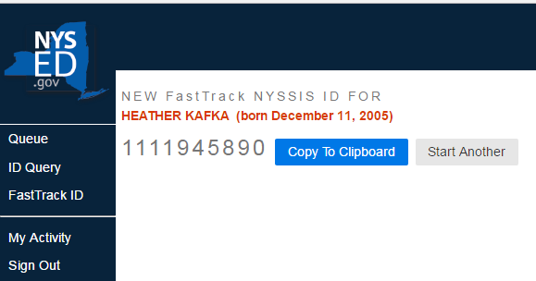
Fast Track NYSSIS ID
Upon generation of a New NYSSIS ID, the ID is available to copy into an SMS or into Nextera Admin.

Slide 8
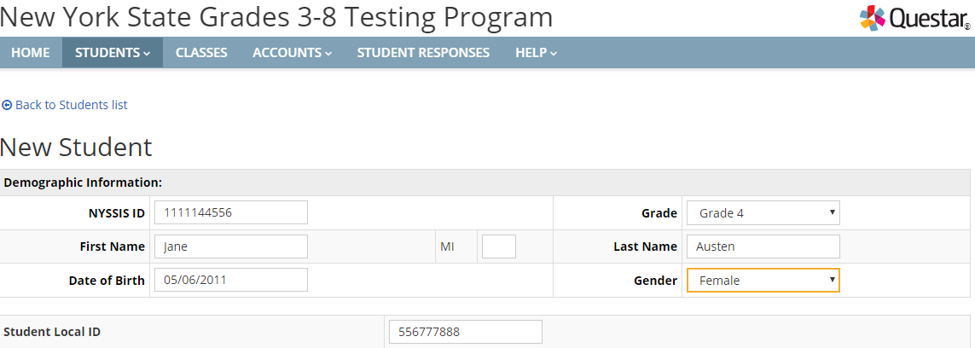
Fast Track NYSSIS ID
Schools can use the Fast Track NYSSIS ID to create a new student in Nextera Admin to provide a username and password for the student to test immediately in CBT:

