Slide 1
Overview and Update High School Diploma Requirements
Combined Project Managers’
Tech Standards Meeting
NERIC
June 2017
Marybeth Casey- NYSED
Associate in Curriculum and Instruction
E-mail: marybeth.casey@nysed.gov

Slide 2
Overview of Topics
Credit Requirements and Earning Credits
Pathways and the Dual Role of CDOS Requirements
Assessment Requirements
Regents
Local
Superintendent’s Determination
Appeals
Social Studies Transition

Slide 3
Requirements
22 Credits accomplished by successfully completing course work
5-8 Assessments accomplished by successfully passing Regents exams, Department approved alternatives or pathway exams
New York State High School Diploma
Notes:
NYS requirements are separate and distinct and do not have to happen simultaneously.
Students may earn diploma credit for successfully completing a course but fail to meet the corresponding Regents assessment requirement; or
Students can fail a course and receive no academic credit but fulfill an assessment requirement if they pass a Regents examination in that course.
As long as students earn the 22 credits in the required disciplines and pass the required assessments in the discipline they meet the diploma requirements

Slide 4
Diploma Types
Regents
4-5 Assessments
Regents with Advanced Designation
7-8 Assessments
Local
4-5 Assessments
22 Credits
Notes:
All students have access to the 3 Basic diploma types
Meeting the requirements for the Regents Diploma and the Advanced Regents Diploma are standard across all student populations
Local diploma requirements vary by subgroup; general education, students with disabilities, and English language learners
The following slides outline the requirements for each subgroup to earn the various diploma types

Slide 5
Earning Credit
Unit of credit is earned by: the mastery of the learning outcomes set forth in a New York State-developed or locally developed syllabus for a given high school subject, after a student has had the opportunity to complete a unit of study in the given subject matter area; or
Credit by Exam: A student earns a passing score of at least 85 on a Regents exam without the completion of a unit of study, completes either an oral examination or a special project.
Credit by exam
http://www.p12.nysed.gov/part100/pages/1005.html#examCredit
Notes:
Mastering the learning outcomes in a given high school course is locally determined. Districts set the course expectations for the weighting of various course requirements: tests, quizzes, class participation, projects etc.
Opportunities for credit by exam are decided by the superintendent and should be made by applying the expectations spelled out in the regulation. Credit by exam is only available for courses that culminate in a Regents exam and is intended for students who do NOT complete courses.

Slide 6
Distribution of Credits
 | Local Diploma, Regents Diploma, Regents Diploma with Advanced Designation
Content Area | Minimum Number of Credits
English | 4
Social Studies Distributed as Follows: U.S. History (1) Participation in Government (1/2) Economics (1/2) Other (2) (students entering grade 9 in 2016 must earn 2 credits in Global History and Geography) | 4
Science Distributed as Follows: Life Science (1) Physical Science (1) Life Science or Physical Science (1) | 3
Mathematics | 3
Languages Other than English (LOTE) | 1*
Visual Art, Music, Dance, and/or Theater | 1
Physical Education | 2
Health | 0.5
Electives | 3.5
Total | 22
*Students with disabilities may be exempt from the LOTE required credit if so indicated on their IEP
Notes:
Every diploma requires 22 units of credits distributed as outlined in the slide
The coursework selected in the various disciplines is locally determined and will depend upon which diploma the student is seeking

Slide 7
Assessment Requirements

Slide 8
Pathways 4+1
CDOS Addition to 4 + 1 Pathway Option
Pathways
All students must pass
4 Required Regents Examinations:
One in each discipline
CDOS
CTE
Math
English
Science
Social Studies
STEM
Humanities
Arts
LOTE
24
Notes:
In March 2016 the Board of approved another option to expand the current 4+1 pathway option to include a 4 + CDOS Pathway. This is now available to students otherwise eligible to graduate beginning June 2016 and thereafter.
First: the regulatory change allows all students to earn the CDOS credential. Previously only students with disabilities had access to this credential.
Second: The regulation allows the +1 pathway option to be fulfilled by the CDOS credential rather than a 5th assessment. Students have to pass one test in each discipline and then meet all the requirements described to earn the CDOS credential.

Slide 9
How do students meet the Pathway Requirements toward a Regents or Local Diploma?
23
Notes:
The Board has approved 6 pathway options for students.
CTE: Approximately 34 Available Exams.
STEM: 18 Total Exams: 5 available Regents exams plus 13 Department Approved Alternatives in Math and Science
Humanities: 9 Total Exams: 1 additional Regents exam in Social Studies plus 8 Department Approved Alternatives in ELA and Social Studies
Arts: 9 Total Exams
Biliteracy: Exams in the review process
CDOS: In lieu of a 5th assessment a student can complete the requirements for the CDOS Commencement Credential.

Slide 10
Meeting the assessment requirements for a STEM Pathway
STEM
Any additional Math or Science Regents exam or any Math or Science exam from the list of Department Approved Alternatives, after a student has completed a course in the subject.
23

Slide 11
Meeting the assessment requirements for a Humanities Pathway
Humanities
Any additional Social Studies Regents Exam or any Social Studies or English exam from the list of Department Approved Alternatives after a student has completed a course in the subject.
23

Slide 12
Meeting the Assessment Requirements for an Arts Pathway
Arts
Any assessment from the list of Department Approved Arts Pathway Assessments after a student has been prepared in the associated content
23

Slide 13
Meeting the assessment requirements for a LOTE Pathway
Biliteracy (LOTE)
This pathway is not currently available. Examinations are under review and will be posted on the Multiple Pathway page once approved.
Multiple Pathways Resources
http://www.p12.nysed.gov/ciai/multiple-pathways/
23

Slide 14
Meeting the Program and Assessment Requirements for a CTE Pathway
CTE
After a student has successfully completed a Department approved CTE Program s/he passes an approved CTE Pathway Assessment found at the link below. The student must successfully complete BOTH the program and the assessment. Not all CTE technical assessments are approved as CTE Pathway Assessments
Multiple Pathways Resources
http://www.p12.nysed.gov/ciai/multiple-pathways/
23

Slide 15
Meeting the Program or Assessment Requirements for a CDOS Pathway
CDOS
Students who complete all the components of the CDOS commencement credential option 1 (program) or option 2 (assessment) may use that credential to meet the +1 pathway requirement toward a local or Regents diploma. Note:CDOS may also be earned as a standalone credential for those student unable to meet the other requirements of a Regents or local diploma
Multiple Pathways Resources
http://www.p12.nysed.gov/ciai/multiple-pathways/
23

Slide 16
Dual Role of CDOS
CDOS as a Pathway to Local or Regents Diploma
CDOS as a Standalone Credential
Passing Regents Examinations in
ELA
Math
Science
Social Studies
All the CDOS Credential Requirements
Students attempt, but do not successfully complete all the Regents or local diploma requirements but do complete all the CDOS credential requirements

Slide 17
CDOS Commencement Credential Requirements – 2 Options
CDOS Commencement Credential – Option 1
216 hours of CTE coursework and/or work-based learning experiences (of which at least 54 hours must be in work-based learning experiences)
CDOS Commencement Credential – Option 2
Demonstrated achievement of CDOS Standards
Employability Profile
Career Plan
Available to all students except students assessed using the New York State Alternate Assessment seeking the Skills and Achievement Commencement Credential. Available as a stand alone credential or added to a Local or Regents diploma.
Available to all students except students assessed using the New York State Alternate Assessment seeking the Skills and Achievement Commencement Credential. Available as a stand alone credential or added to a Local or Regents diploma.
National Work Readiness Credential;
SkillsUSA Work Force Ready Employability Assessment;
National Career Readiness Certificate WorkKeys - (ACT);
Comprehensive Adult Student Assessment Systems Workforce Skills Certification System.
Criteria:
Criteria - meeting the requirements for one of the nationally recognized work readiness credentials
Notes:
Two available options to meet the requirements for the credential

Slide 18
What is the Difference
Between a Regents and
Local Diploma?
The answer depends on two factors:
To which subgroup does a student belong
Student with a Disability
English Language Learner
General Education
What scores did the student attain on the
required examinations for graduation.

Slide 19
Assessment Requirements –Regents Diploma
 | Regents Diploma for all students |  | Regents Diploma via Appeal for all students
Regents Exam or passing score on a Department Approved Alternative | # of Exams | Passing Score | # of Exams | Passing Score
English Language Arts (ELA) | 1 | 65 | 1 | 1 exam with a score of 60-64 for which an appeal has been granted by the district and all other required exams with a 65 or greater
Math | 1 | 65 | 1
Science | 1 | 65 | 1
Social Studies | 1 | 65 | 1
Pathway | 1 (or CDOS) | 65 if Regents Exam | 1 (or CDOS)
Compensatory Safety Net | Non Applicable |  | Non Applicable
Department Approved Alternatives to Regents Exams can
be found at: http://www.p12.nysed.gov/assessment/hsgen/archive/list.pdf
Notes:
The various diploma types are differentiated by 2 factors
The passing score on the examinations used to meet the diploma requirements
The number of assessments a student successfully passes
All diplomas call for students to pass a minimum of 1 examination in each discipline; ELA, Math, Science, Social Studies, plus 1 pathway assessment (or CDOS)
Pathway assessments consist of the following:
An additional math or science Regents exam in a different course from that which was used in the 4 required exams
An additional social studies Regents exam in a different course
Any exam from the list of Department approved alternative examinations in a different course
Any exam from the list of Department approved technical assessments after successfully completing a Department approved CTE program
A Department approved arts pathway or LOTE pathway examination.
In lieu of a Pathway assessment (1-5 above) a student can meet the requirements for a CDOS commencement credential and graduate with 4 exams + CDOS
The Regents diploma requires each student to pass 5 examinations with a 65 or better (or 4 exams +CDOS) or 4 examinations (or 3+CDOS) with a 65 and 1 examination with a 60-64 for which an appeal has been granted by a local district.

Slide 20
Local Diploma – 4 Ways
⁽¹⁾All Students - Appeal
 | Local Diploma via Appeal for All Students
Regents Exam or passing score on a Dept. App. Alt | # of Exams | Passing Score
English Language Arts (ELA) | 1 | 2 exams with a score of 60-64 for which an appeal has been granted by the district and all other required exams with a 65 or greater
Math | 1
Science | 1
Social Studies | 1
Pathway | 1 or CDOS
Compensatory Safety Net | Non Applicable
Notes:
All students can meet the local diploma requirements by:
Passing 3 required examinations with a 65 or better; and
Passing 2 required examinations with a 60-64 for which an appeal is granted by the local district
(Students with disabilities can use this option but would not need to because they have access to the low pass safety nets
This is the only avenue that provides for a general education student to earn a local diploma

Slide 21
⁽²⁾English Language Learner - Appeal
 | Local Diploma via Appeal for English Language Learners
Regents Exam or passing score on a Dept. App. Alt | # of Exams | Passing Score
English Language Arts (ELA) | 1 | ELA with a score of 55-59 for which an appeal has been granted and all other required exams with a score of 65 or greater OR 1 exam with a score of 60-64 and ELA with a score of 55-64 for which appeals have been granted by the district and all other required exams with a score of 65 or greater
Math | 1
Science | 1
Social Studies | 1
Pathway | 1 or CDOS
Compensatory Safety Net | Non Applicable
Notes:
English Language Learners
English Language Learners can appeal a score as low as 55 on their ELA exam only. If the student uses this flexibility, the most they can earn is a local diploma. The student can however appeal a second exam within the score range of 60-64 and still qualify for a local diploma.
Passing 4 exams with a minimum score of 65 and ELA with a score of 55-59 for which an appeal is granted by the local district
Passing 3 exams with a minimum score of 65, and 1 exam with a score of 60-64 and ELA with a score of 55-64 for which appeals has been granted by the district
Note: If the student uses a CDOS pathway they are still eligible to appeal up to two examinations

Slide 22
⁽³⁾Students with a Disability Low Pass Safety Nets
 | Local Diploma for Students with a Disability via low pass safety nets
Regents Exam or passing score on a Dept. App. Alt | # of Exams | Passing Score
English Language Arts (ELA) | 1 | 55*
Math | 1 | 55*
Science | 1 | 55* ^
Social Studies | 1 | 55* ^
Pathway | 1 or CDOS | 55* ^ ( if Regents exam)
Compensatory Safety Net | Scores of 45-54 on any required Regents exam (except ELA and Mathematics) can be compensated by a score of 65 or above on another required Regents exam including ELA and Mathematics.
*Students with a disability seeking the local diploma through the low pass safety-net may
appeal scores of 52-54 on up to two Regents Examinations.
^ Students with a disability who are unable to obtain a passing score on these examinations may seek a
local diploma by Superintendent’s Determination. See http://www.p12.nysed.gov/specialed/publications/2017-memos/superintendent-determination-of-graduation-with-a-local-diploma-updated.htm
Notes:
Students with disabilities can meet the local diploma requirements by:
Low Pass Safety Net: Passing 5 exams with a 55-64
Compensatory Safety Net: Scoring 45-54 on any required Regents exam (except ELA and Mathematics) by compensating with scores of 65 or above on other required Regents exam including ELA and Mathematics.
Appeal: Passing 3 required examinations with a 55 or better and 2 examinations with a 52-54 for which an appeal is granted by the local district.
Superintendent Determination : See http://www.p12.nysed.gov/specialed/publications/2017-memos/superintendent-determination-of-graduation-with-a- local-diploma-updated.htm

Slide 23
⁽⁴⁾Superintendents Determination of a Local Diploma
Added as an option at the June 2016 BOR meeting amended October 2016
Eligibility:
Student with a current IEP
Passed ELA and Math Regent exams with a score of 55 or has successfully appealed a score of 52-54
has participated in the other Regents exams (science and social studies), but has not passed one or more of these as required for graduation
demonstrated competency in the subject area where the student was not able to demonstrate his/her proficiency of the State’s learning standards through the Regents exam
Earned all required credits and passed, in accordance with district policy, all courses required for graduation
Applicable to June 2016 grads and thereafter
Info. and forms: http://www.p12.nysed.gov/specialed/publications/2017-memos/superintendent-determination-of-graduation-with-a-local-diploma-updated.htm
Notes:
The Superintendent of the public school district or the principal of a registered non-public or Charter school may make this determination
Not applicable to students with a 504 plan regardless of access to the other safety nets.

Slide 24
Superintendent Determination
The Superintendent may only conduct review after receipt of a written request from an eligible student’s parent or guardian.
The definition of superintendent for purposes for this regulation only shall include the principal or head of school of charter schools and non-public schools, as applicable.
The student and the parent of the student must receive written notice of the superintendent’s determination with the copy of the completed form.
Notes:
Here are the Proposed Revisions of section 100.5(d)(12) in response to public comment:
As of October 18th
The Superintendent may only conduct review after receipt of a written request from an eligible student’s parent or guardian.
The revisions also
Clarify the definition of superintendent for purposes for this regulation only shall include the principal or head of school of charter schools and non-public schools, as applicable.
And that
The student and the parent of the student must receive written notice of the superintendent’s determination with the copy of the completed form.

Slide 25
Superintendent Determination
Where the superintendent determines the student :
has met the requirements for graduation, the district must provide prior written notice that the student is not eligible to receive a free appropriate public education after graduation with a local diploma
has not met the requirements for graduation, the written notice shall inform the student and parents that the student has the right to attend school until receipt of a local or Regents diploma or until the end of the school year in which the student turns age 21, whichever shall occur first;
Notes:
Proposed Revisions of section 100.5(d)(12):
Also
Where the superintendent determines the student :
has met the requirements for graduation, the district must provide prior written notice that the student is not eligible to receive a free appropriate public education after graduation with a local diploma
And
Where the superintendent determines the student :
has not met the requirements for graduation, the written notice shall inform the student and parents that the student has the right to attend school until receipt of a local or Regents diploma or until the end of the school year in which the student turns age 21, whichever shall occur first;

Slide 26
Superintendent Determination
For students of transition age, the development of transition goals and services at a CSE meeting must include a discussion, with the student and parents, of:
the graduation requirements that apply to the student;
the student’s progress toward receiving a diploma;
the courses the student has passed and the number of credits the student has earned as required for graduation;
the assessments required for graduation that the student has taken and passed; and
the appeal, safety net and superintendent determination pathway options that may be available to the student to meet the graduation assessment requirements.
Notes:
In addition there are also Proposed Revisions of section 200.4(d)(2)(ix):
This requires that, for students of transition age, the development of transition goals and services at a CSE meeting must include a discussion, with the student and parents, of
the graduation requirements that apply to the student
depending upon the year in which he or she first enters grade nine
of the student’s progress toward receiving a diploma and
the courses the student has passed and the number of credits the student has earned as required for graduation;
the assessments required for graduation that the student has taken and passed; and
the appeal, safety net and superintendent determination pathway options that may be available to the student to meet the graduation assessment requirements.
that parents be provided with information explaining graduation requirements, including eligibility criteria and process for requesting the superintendent determination.

Slide 27
Appeal Process

Slide 28
Appeal Criteria
Students seeking an appeal must meet the following criteria:
Have taken the Regents examination under appeal at least two times;
Have at least one score on the Regents examination under appeal within the point range
appropriate for the appeal.
All student appeal score band (60-64) Students with disabilities seeking the local
diploma - score band 52-54
English language learner seeking an appeal on ELA only - score band 55-59
Have taken advantage of academic help provided by the school in the subject
tested by the Regents examination under appeal;
Have passed the course for which the appeal is being sought
Be recommended for an exemption to the graduation requirement by the student’s
teacher or Department chairperson in the subject of the Regents examination under
appeal.
Note:
English Language Learners seeking an appeal for a score of 55-59 on the ELA Regents
Exam are only eligible for an appeal in this area if they entered the United States in grade 9 or
after and were classified as an ELL when they took the test the second time.
http://www.p12.nysed.gov/ciai/gradreq/CurrentAppealForm.pdf
Notes:
This slide illustrates the criteria all students need to meet in order to appeal to graduate with a lower score on a Regents Examination.
Appeal criteria for students seeking the local diploma through the low pass safety net option and other students seeking the Regents or local diploma are the same
English language learners seeking an appeal of a 55-59 on the ELA Regents in order to earn a local diploma must meet the additional criteria of having entered the US in grade 9 or after and they must be classified as an ELL at the time they took the ELA Regents exam for the second time.
NEW: At the March 2016 Board of Regents meeting the minimum 95% attendance requirement was repealed and is no longer a criteria for a student seeking an appeal
NEW: At the March 2016 Board of Regents meeting the score band on the appeal was extended to 60-64 from the previous 62-64 for the all student appeal.

Slide 29
Appeal Committee and Review
Appeal is Submitted
Student
Appeal Committee
Principal
Recommendation to the Superintendent
Grant Appeal
Parent
Teacher/Counselor
3 Teachers
(not students teacher)
Administrator
Deny Appeal
Notes:
An Appeal can be submitted by the student, a teacher/guidance counselor or a parent
Once an appeal is filed, the committee shall convene and make a recommendation to the Superintendent, or in the case of New York City, the Chancellor or his/her designee within 10 days of when the appeal is submitted.
If an appeal is filed the process must begin. It is not the judgement of any one person in the school not to allow an appeal to be submitted.
The committee makes a determination based upon the eligibility criteria whether or not to recommend to the Superintendent that the student’s appeal be granted or denied
The committee should base the recommendation upon the criteria.

Slide 30
Transfer Students
Students who transfer to a NY State School for the first time in:
Grade11 – May be exempt from the Global History and Geography exam. Must pass ELA, Math, Science, US History = 4 Exams These students may also be exempt from the required 2 units of Global instruction and substitute other social studies courses to meet the 4 required credits in Social Studies
Grade 12 – May be exempt from Global History and Geography and Science. Must pass ELA, Math, US History = 3 Exams
Notes:
The principal of the receiving school may examine the transcript of a student who enters the high school in any grade, and award credit for work done in another school.
The principal must accept any credits awarded at a Registered Public School in NY
Students who have completed coursework that is aligned to a Regents examination in a school outside of NY, may be admitted to a Regents examination if the coursework is aligned to the exam and reasonably has prepared the student for the content assessed.
Documentation or a letter attesting to the required laboratory minutes is necessary for admission to a science Regents exam.
The principal may accept a substitution for the required Social Studies coursework in Global Studies, Economics and Participation in Gov’t but all students must have a one credit course in US History and must graduate with a total of 4 Social Studies credits.

Slide 31
Social Studies Transition Exam
Impacts students entering grade 9 in September 2016
Impacts Global History and Geography exams administered in June 2018-January 2020
What will be assessed on the Transition Exam?:
Existing Core Curriculum (not new Frameworks)
Course Year 2 (Grade 10) Only (1750-Present)
Retains the structure of the current Global Exam.
Uses questions written for the existing Global Regents bank, but only covers content from 1750 – the present, consistent with the configuration of the new Global II Exam
Transition Memo: http://www.p12.nysed.gov/assessment/ss/hs/ghg-faqtransitiontimeline.pdf
Regents Item: http://www.regents.nysed.gov/common/regents/files/616p12a6.pdf

Slide 32
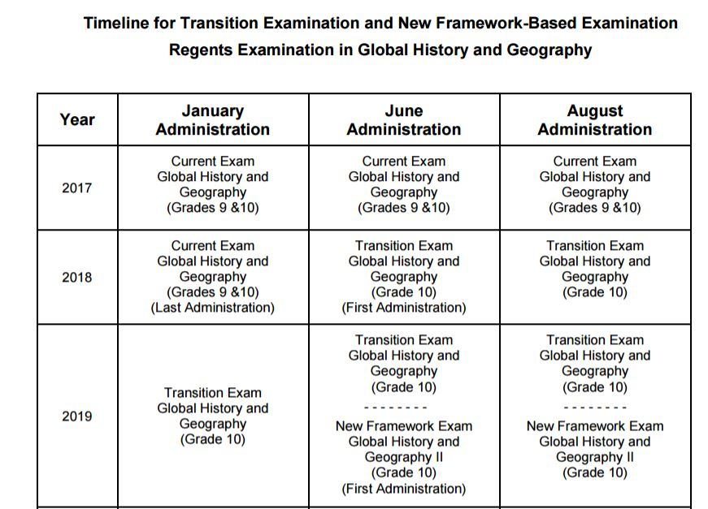
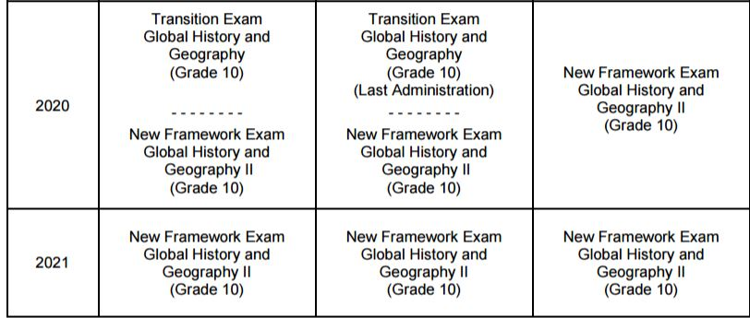
http://www.p12.nysed.gov/assessment/ss/hs/ghg-faqtransitiontimeline.pdf

Slide 33
Helpful Links
Diploma Requirements Chart | http://www.p12.nysed.gov/ciai/gradreq/CurrentDiplomaRequirements.pdf
Diploma Requirements Page | http://www.p12.nysed.gov/ciai/gradreq/intro.html
Multiple Pathways Page | http://www.p12.nysed.gov/ciai/multiple-pathways/
Multiple Pathways Q&A | http://www.p12.nysed.gov/ciai/multiple-pathways/docs/multiple-pathways-pathways-qa-2015-04-08.pdf
Superintendent Determination | http://www.p12.nysed.gov/specialed/publications/2017-memos/superintendent-determination-of-graduation-with-a-local-diploma-updated.htm
Transfer Credit | http://www.p12.nysed.gov/part100/pages/1005.html#transCredit
Appeal To Graduate with a Lower Score | http://www.p12.nysed.gov/ciai/gradreq/appeal-form.pdf
Department Approved Alternative Exams | http://www.p12.nysed.gov/assessment/hsgen/archive/list.pdf
LOTE Guidance | http://www.p12.nysed.gov/ciai/lote/documents/lote-qa.pdf

Slide 34
Where to Get Additional Information
General Ed and Diploma Requirements Web Page:
http://www.p12.nysed.gov/ciai/gradreq/intro.html
NYSED Office of Curriculum and Instruction
http://www.p12.nysed.gov/ciai/
Information Email Box: emscurric@nysed.gov
Graduation Requirements Information E-mail Box
emscgradreq@nysed.gov
Curriculum and Instruction Content Area Associates
http://www.p12.nysed.gov/ciai/aboutus.html
Special Education Information E-mail
speced@nysed.gov
Requests to join the Counselors LISTSERV go to Elizabeth.Whipple@nysed.gov

