Slide 1

Setting
Not Tested Codes in Nextera Admin

Slide 2
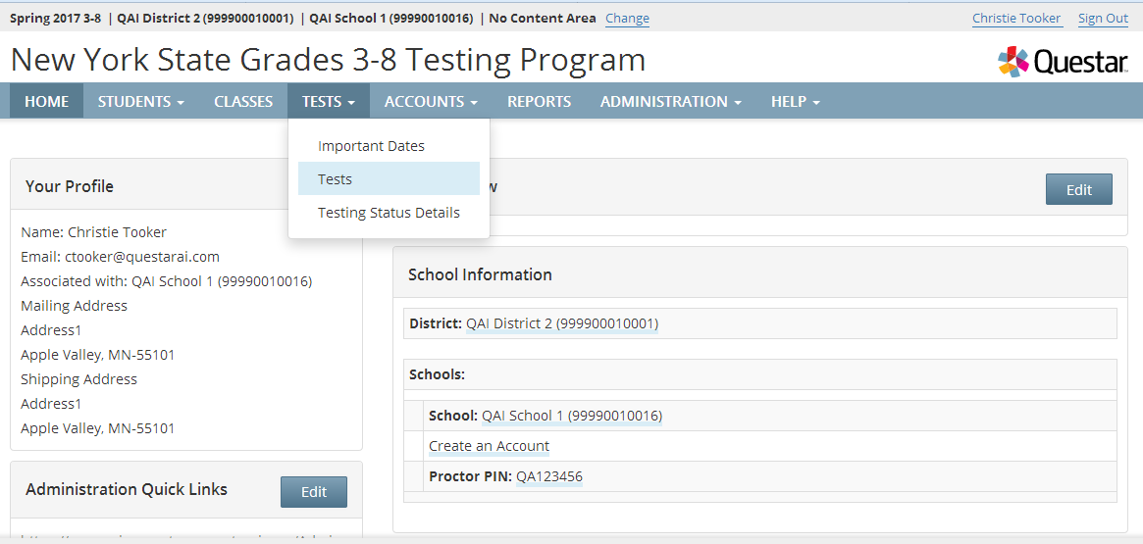
Setting Not Tested Codes
Log in to Nextera Admin
Click “Change” to filter to the appropriate district and school
Click “Tests” > “Tests”
Notes:
The Tests tab is available on the day that Student Login Tickets are available in Nextera Admin Please see the Significant Dates for CBT Timeline for all important CBT dates: https://cbtsupport.nysed.gov/hc/en-us/articles/360020441711-CBT-Timeline-Significant-Events-2019

Slide 3
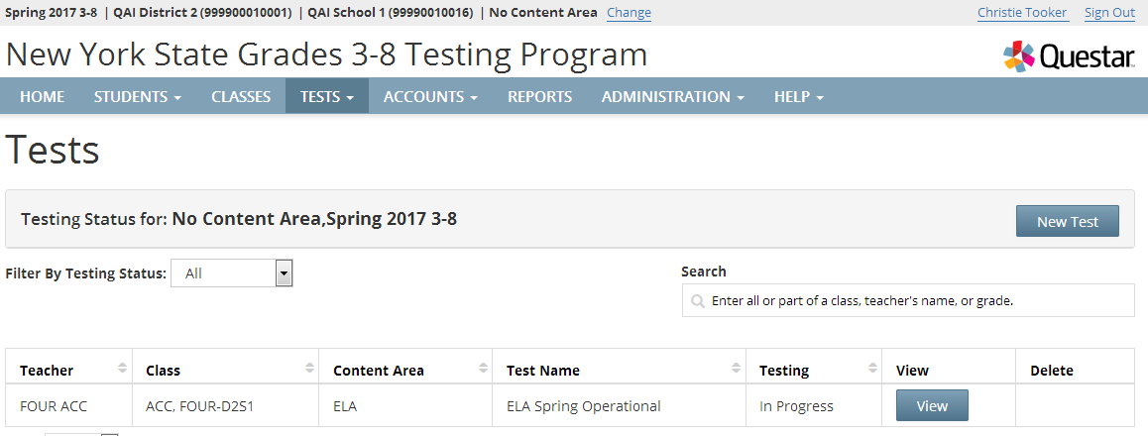
Setting Not Tested Codes
All of the classes for that school or content (depending on how you are filtered), will appear in a list on the Tests page
Click “View” next to the appropriate class

Slide 4
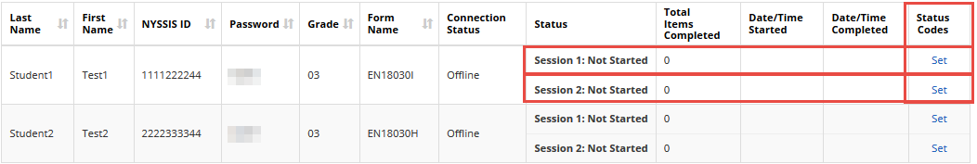
Setting Not Tested Codes
Once you click “View”, scroll down and you will see a list of all students in that class
Each student has two sessions next to their name. A separate status code will need to be set per session, per student
Click “Set” next to the appropriate student/session

Slide 5
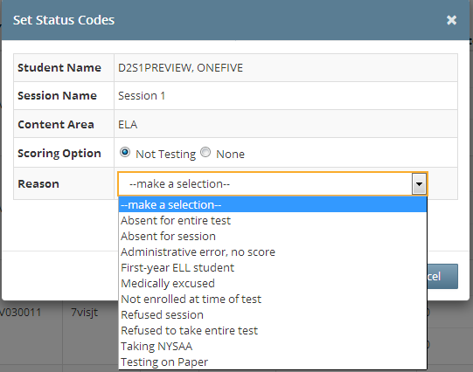
Setting Not Tested Codes
Click “Not Testing” next to Scoring Option
Choose a Reason from the drop-down menu
Click “Submit”
Repeat steps for all students and sessions who are not testing
Notes:
Update for 2019 Administration: The Not Tested Codes “Absent for entire Test” and “Refused to take entire test” are no longer available. Not Tested Codes must be set for each Session 1 and Session 2, so only the related session Not Tested Codes are available for the 2019 CBT administration.

Slide 6
Setting Not Tested Codes
Not Tested Codes:
Absent for session
Administrative error, no score
First-year ELL student
Medically excused
Not enrolled at time of test
Refused session
Taking NYSSA
Taking Regents
Testing on Paper*
Notes:
The “Testing on Paper” Not Tested Code is exclusive to CBT and can only be set in Nextera Admin. Schools will use this code to mark any student who is available in Nextera Admin and testing on paper in a CBT grade level, such as for receiving the Test Read accommodation on paper or for oral translation for CBT math.

Slide 7
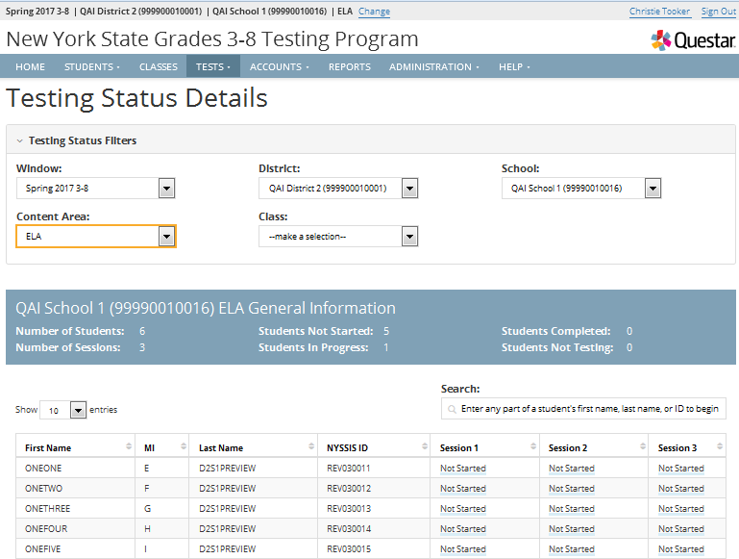
Testing Status Details Page
“Tests tab” > Testing Status Details
On this page, you can see an overview of the session status and export to excel.
Session Status

Slide 8
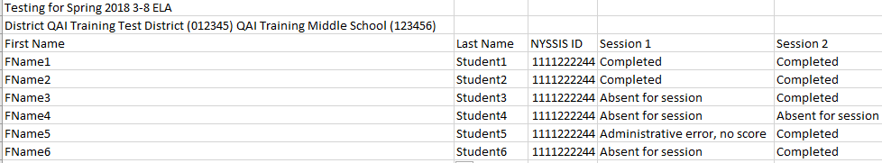
Testing Status Details Page
On the last day of the testing window
Export the Testing Status Details to be sure every student has either tested all sessions or a Not-Tested code has been assigned
  Used to help identify students for makeup tests
Notes:
It is a CBT Best practice to review this report after primary CBT administration within your school. Every student should either have a “Completed” status or a Not Tested Code indicated for each test session.

Slide 9
Customer Support
Questar New York Customer Support
NY.3-8.help@questarai.com
866-997-0695

