Slide 1
Teacher-Student Data Linkage Update
DATAG
December 2, 2011
Notes:
1

Slide 2
Complexities
  Multiple teachers responsible for student learning outcomes:
    Co-teachers
    Push-in teachers
    Pull-out sections
  Changes over time in teacher assignments
  Changes over time in student enrollment
  Changes over time in student attendance

Slide 3
Linkage Data Elements
Multiple teachers assigned to a course section
Teacher-student linkage to be expressed as a proportion to reflect changes over time:
  Duration* of student enrollment-teacher assignment linkage for course (minutes) – Field 14
  Duration* of student attendance-teacher assignment linkage for course (minutes) – Field 15
  Duration* of course (minutes) – Field 18
  Teacher-student linkage start/end dates
Teacher-student linkage duration adjustments (correction for hard-to-schedule situations)
Student exclude flag
* As of state assessment date

Slide 4
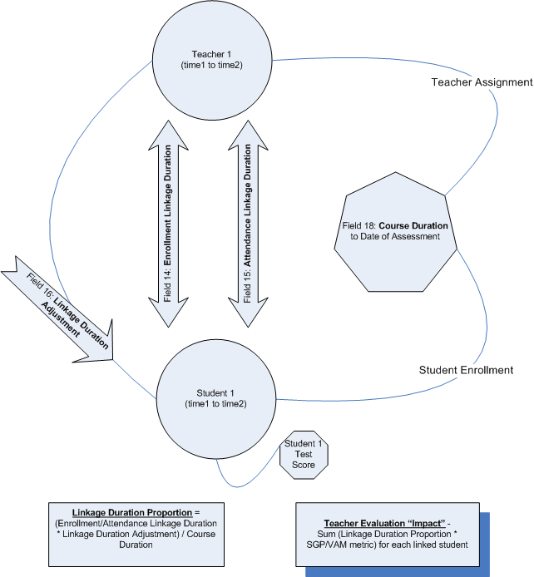
Draft Conceptual Model

Slide 5
Linkage Issues
  State data system capacity sufficient to enable policy options
  Rules for “exclude flag”
  Vendor capacity
    Fidelity of student management system extracts
    Human resource management systems
  LEA capacity
    LEAs without student management systems
    Roster verification
      Daily verification while taking attendance
      On-demand verification access (weekly refresh)
      End-of-cycle verification (linkage deadline shortly after assessment administration)
      Auditing of extracts

